Slide 1
Machine Vision Applied to Vehicle Telematics
Tyler Rosacker

Slide 2

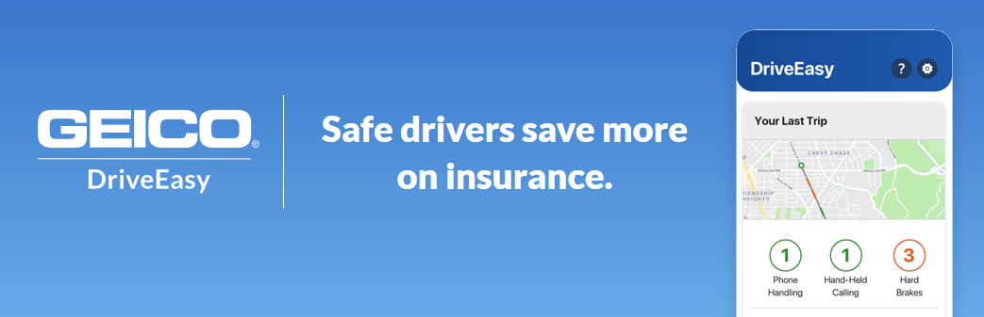
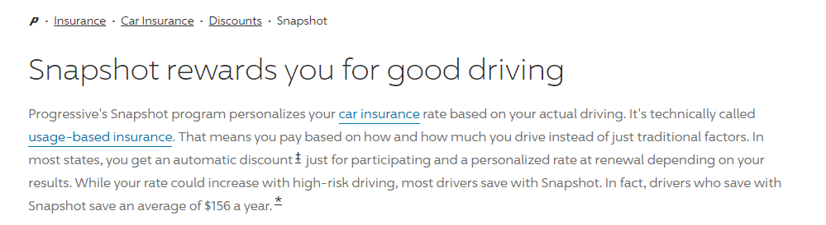
Background - Telematics
Most insurers offer “telematics” programs
Systems are based on:
GPS
Accelerometer
Other Phone Sensors
What’s Missing?
Using the phone camera!

Slide 3
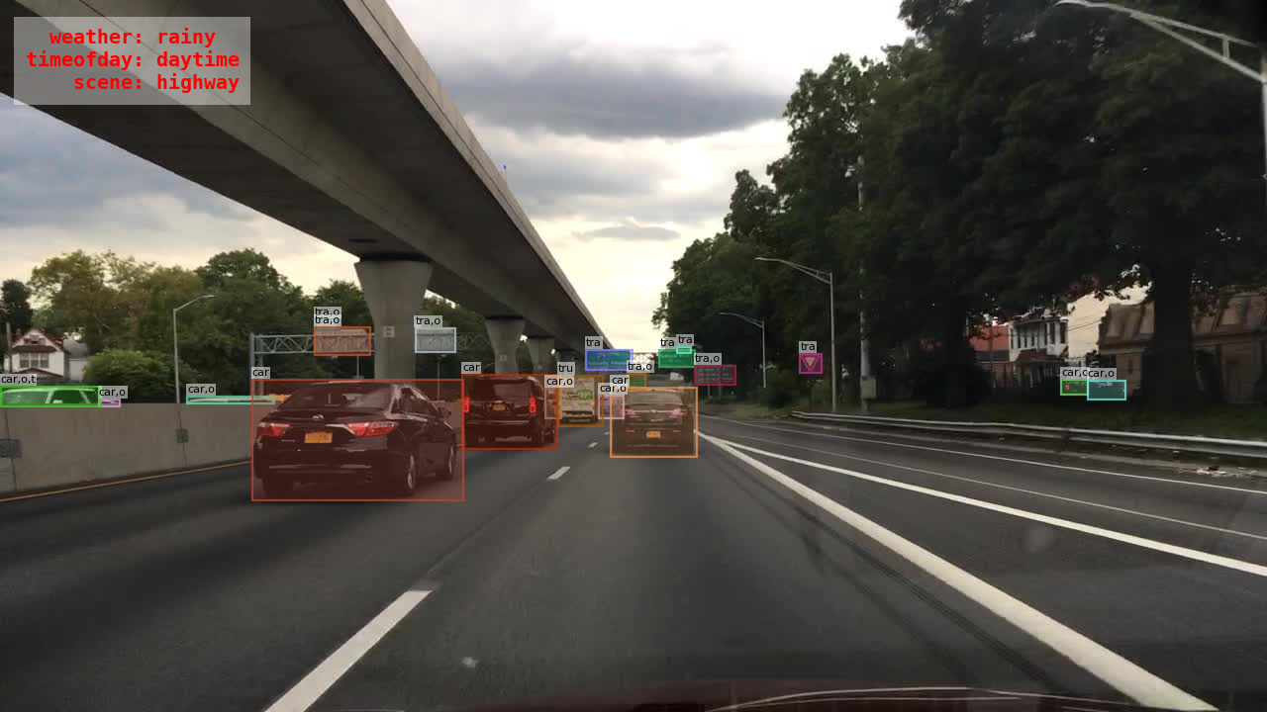
Concept
Notes:
The concept for this research is that additional data could be obtained using machine vision.
In this example photo, you can see global labels “rainy”, ‘daytime”, “highway”, but also object specific labels like “this is a car” or “this is a street sign”.
All of this data would be meaningful for a telematics program!

Slide 4
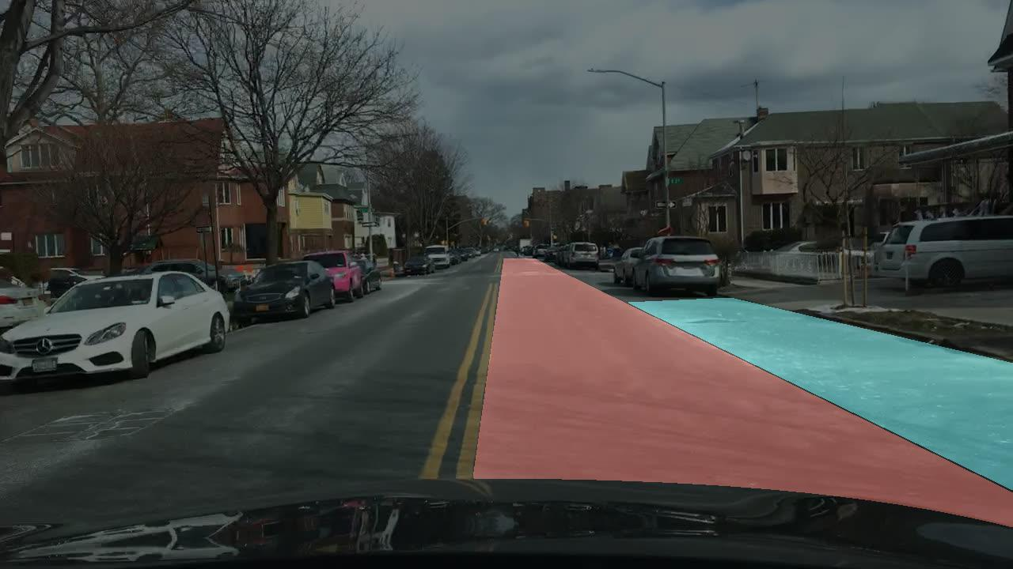
Dataset
BDD100K from Berkeley
100,000 images
10 different tasks
Some Warnings
Open source (but not for commercial use!)
Major Cities Only
Notes:
The best dataset out there for this type of concept is the BDD100k dataset from Berkeley
The dataset has a ton of different domains you can model on and has been used for a lot of research and competitions over the last few years, so good benchmarks exist.
The tasks are things like “detect the vehicles” or “segment the drivable area” or “detect the pose of pedestrians”.
One big thing to note is this data isn’t for commercial use, so if a company wanted to recreate the research I’m about to talk about, they’d need to talk licensing agreements first
Another big warning is the data has a bit of a geographic bias. It comes only from major cities, so if you try to build a model that generalizes to other parts of the US, you’ll probably have issues.

Slide 5
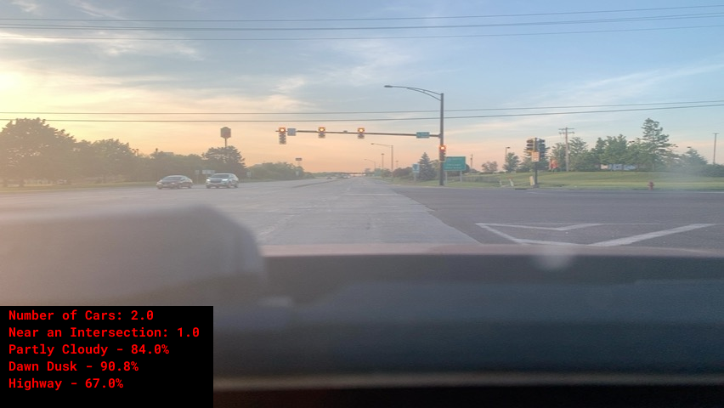
The Models
Sagemaker Models
“Weather”
“Time of Day”
“Street Category”
AWS Rekognition
“On-the-shelf” machine vision from Amazon
Tons of labels!
Cars, Trucks, Snowplows
Downtown, Metropolis, Gas Station
Deer, Elk, Elephants

Slide 6
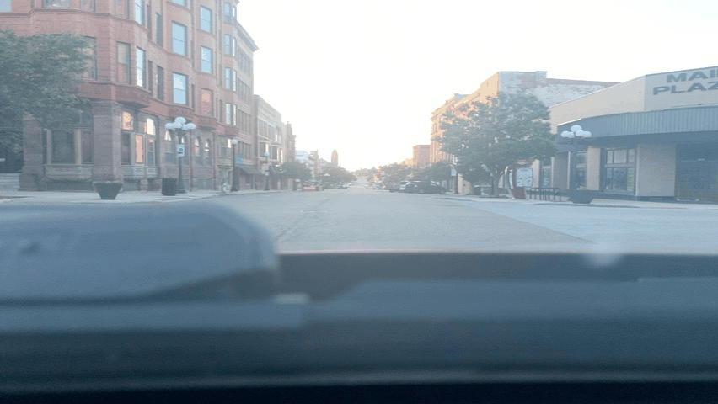
Data Capture
Built website to capture images on phone
Also captures GPS data
Images loaded to AWS account
Available for downstream ML processing

Slide 7
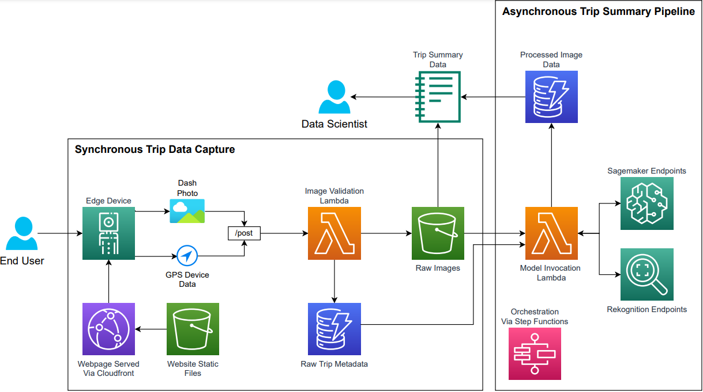
Architecture

Slide 8
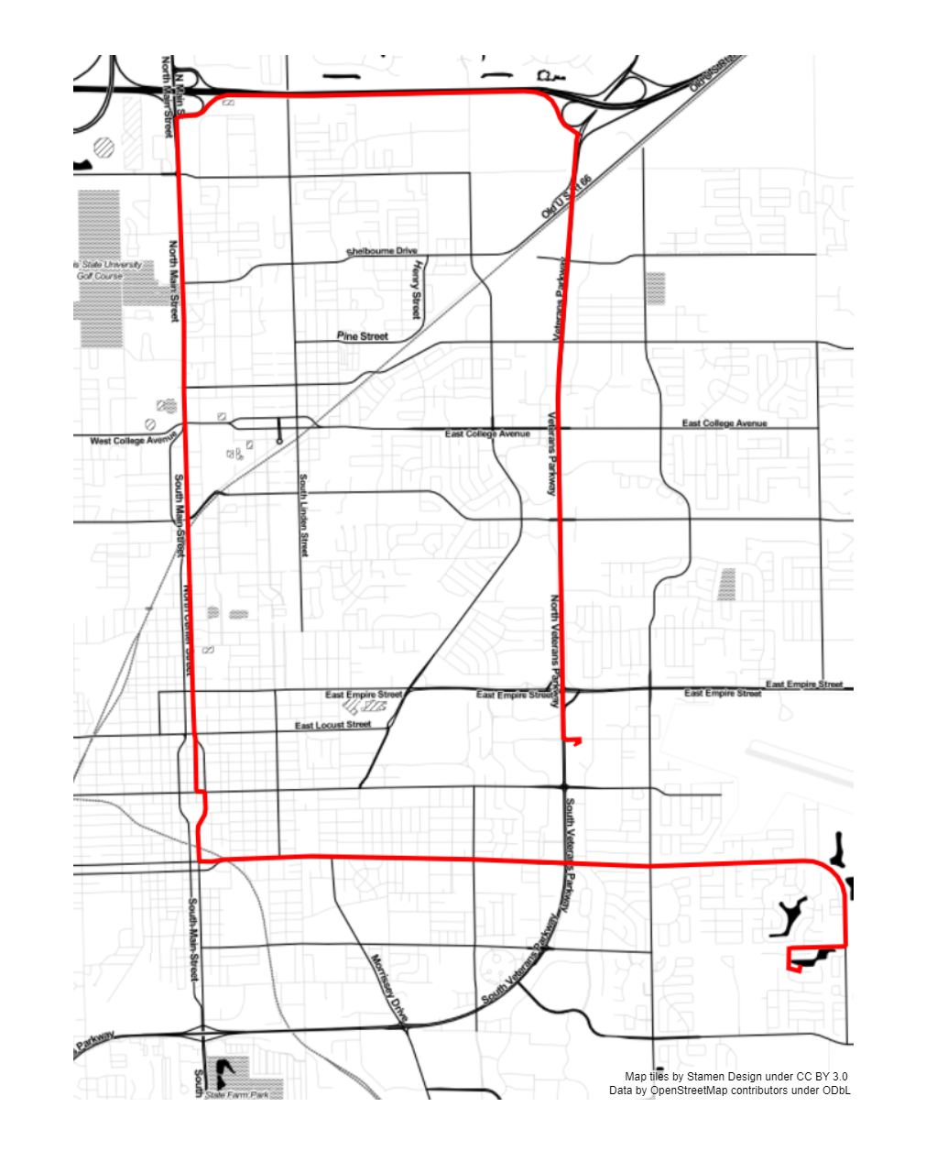
Road Test
Road trip around Bloomington, IL
~30 minutes long
Around 1 hour before sunset

Slide 9
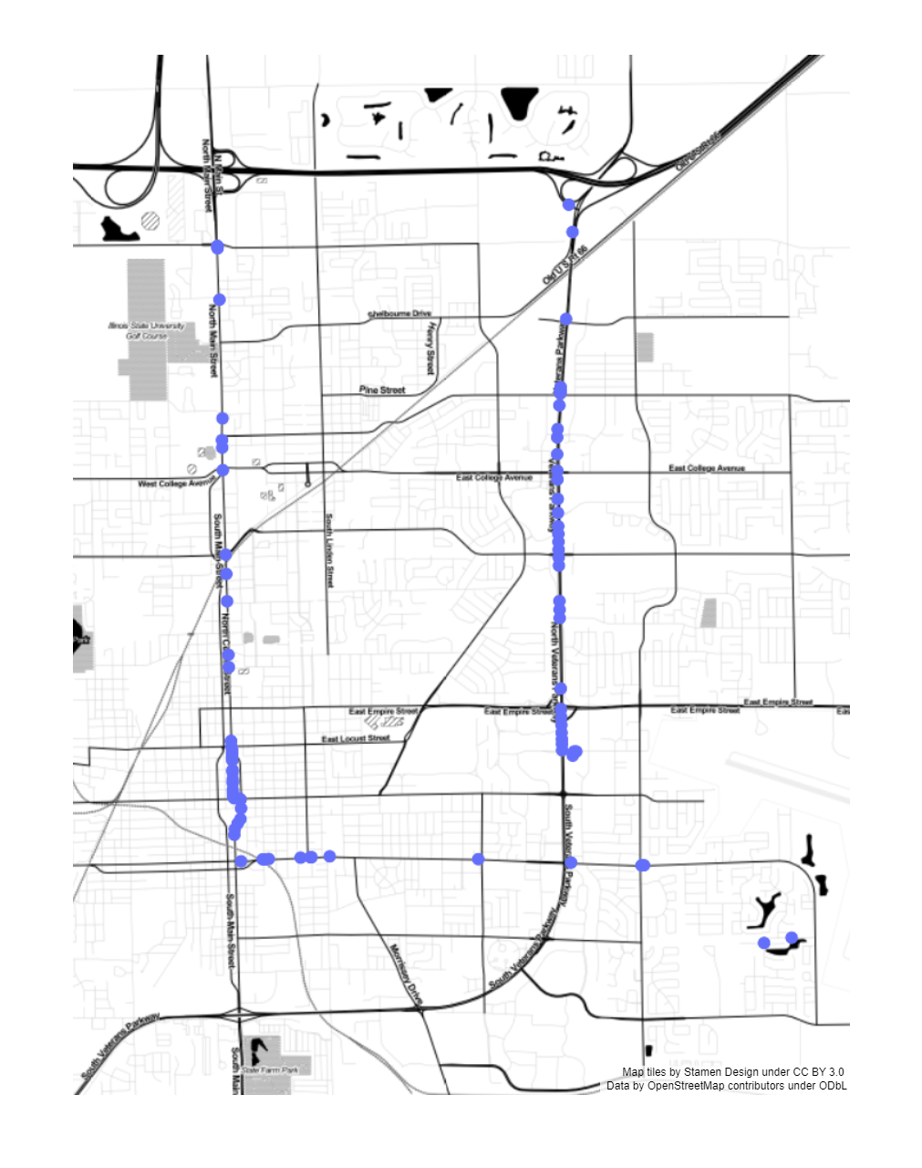
Road Test
Road trip around Bloomington, IL
~30 minutes long
Around 1 hour before sunset
Intersection Detection
Decent, but misses small intersections

Slide 10
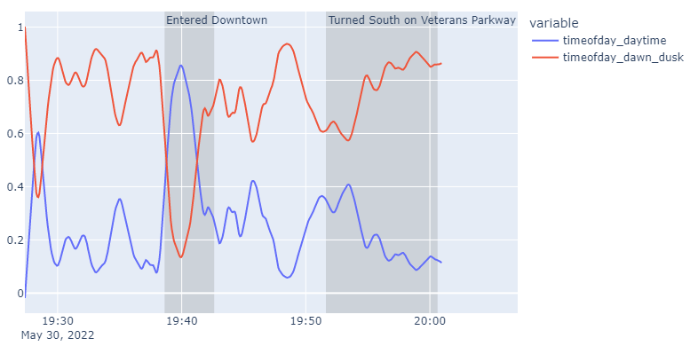
Road Test
Notes:
This shows the confidence the model had in “time of day”. You can see mostly it does a consistent prediction of “dusk”. However, it really loses confidence while in downtown with the higher building heights.

Slide 11
Future Research – Insurance Pricing
Aggregate model predictions into trip or time period summarizes
Use as feature in insurance pricing models
Variable | Value
Percent time spent driving in rain | 10%
Percent time spent driving in snow | 5%
Percent time spent driving at dusk | 8%
Percent time spent driving on highways | 23%
Average Cars Visible | 1.23
Average Number of Intersections Per Trip | 13.2
Insurance Pricing GLM

Slide 12
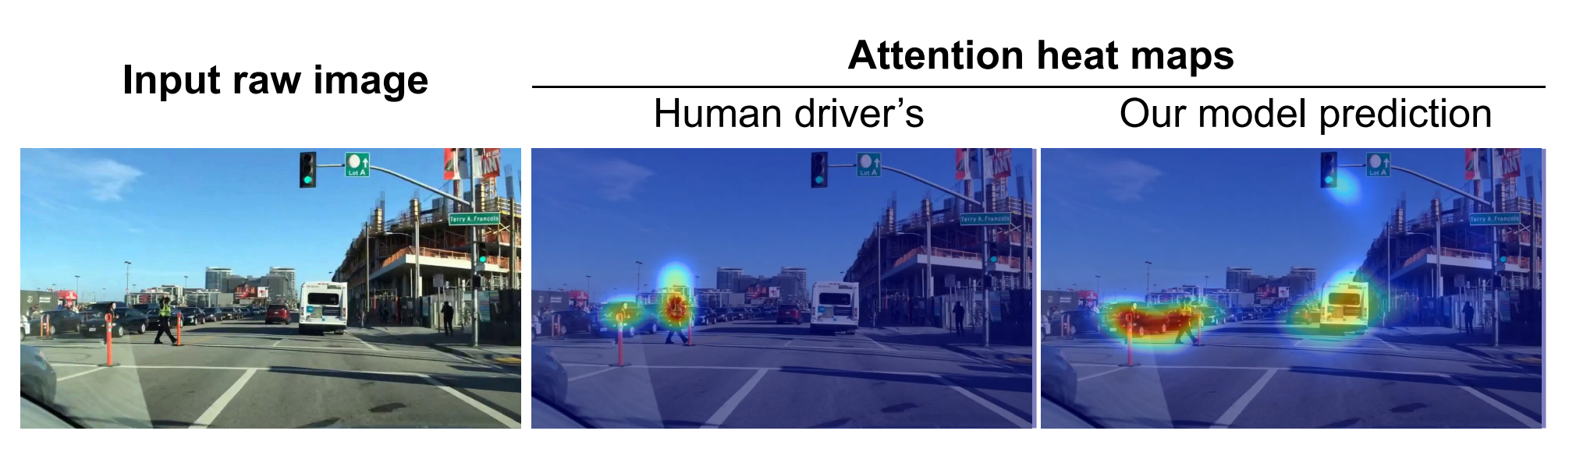
Future Research – Driver Attention
Predict driver attention to different hazards
Is their attention likely to be split right now?

Slide 13
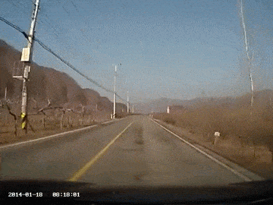
Future Research –Braking Response
Can we give context behind hard braking events?
Fast response speed to hazard
Responsible stopping at lights

